Slide 1

Project Title-Telecom churn case study
Name-
1) Mayur Sudhir Chavhan
Mentor Name- Saurabh Singh
Date-29/06/2023

Slide 2

Content
Problem Statement
Business Overview
End-to-End Process of ML
Dataset Summary
Exploratory Data Analysis
Data Visualisation
Feature Engineering/Selection
Model Building
Model Deployment
Challenges
Future Scope
Conclusion

Slide 3

Problem Statement
A Telecom company is losing Customers to its competitors. With the historical customer churn information that they have, they want a ML Model to predict, which of their present customers may churn.

Slide 4
Business Overview
In the telecom industry, customers are abled to choose from multiple service providers and actively switch from one operator to another.
In this highly competitive market, the telecommunications industry experiences an average of 15-25% annual churn rate.
Given the fact that it costs 5-10 times more to acquire a new customer than to retain an existing one, customer retention has now become even more important than customer acquisition.
For many incumbent operators, retaining high profitable customers is the number one business goal.
To reduce customer churn, telecom companies need to predict which customers are at high risk of churn.
In this project, we will analyze customer-level data of a leading telecom firm, build predictive models to identify customers at high risk of churn and identify the main indicators of churn.

Slide 5
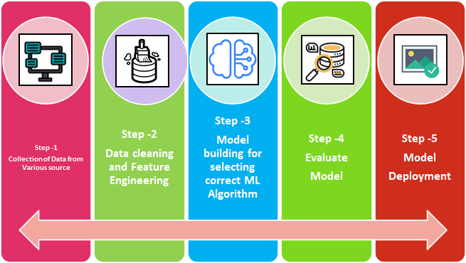
End-to-End Process of Machine Learning Model

Slide 6
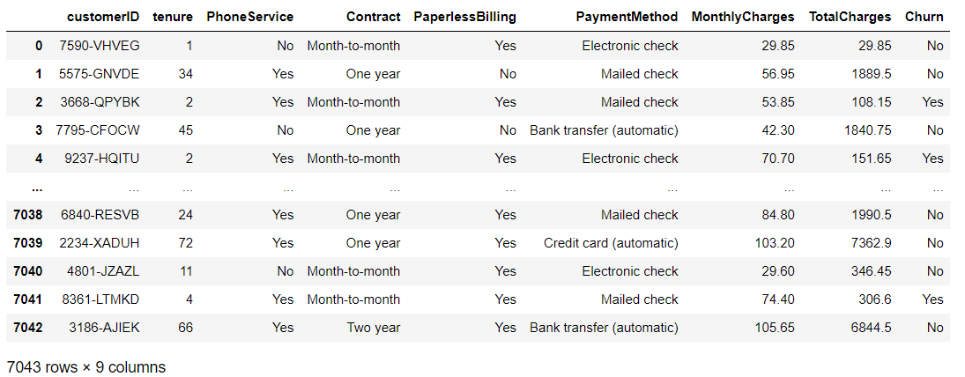
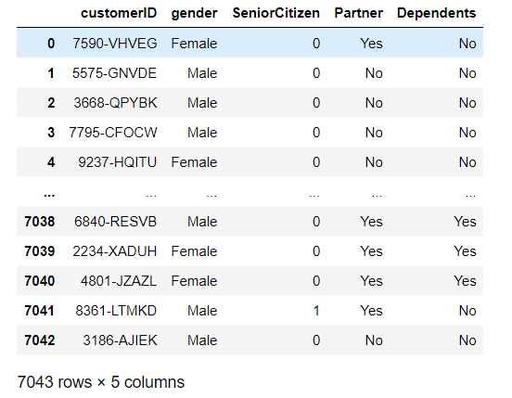
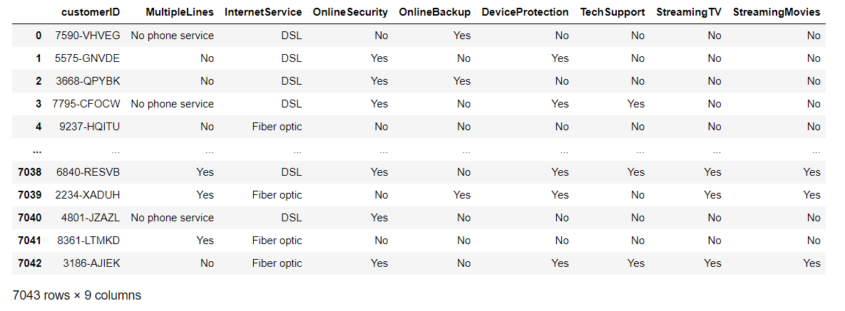
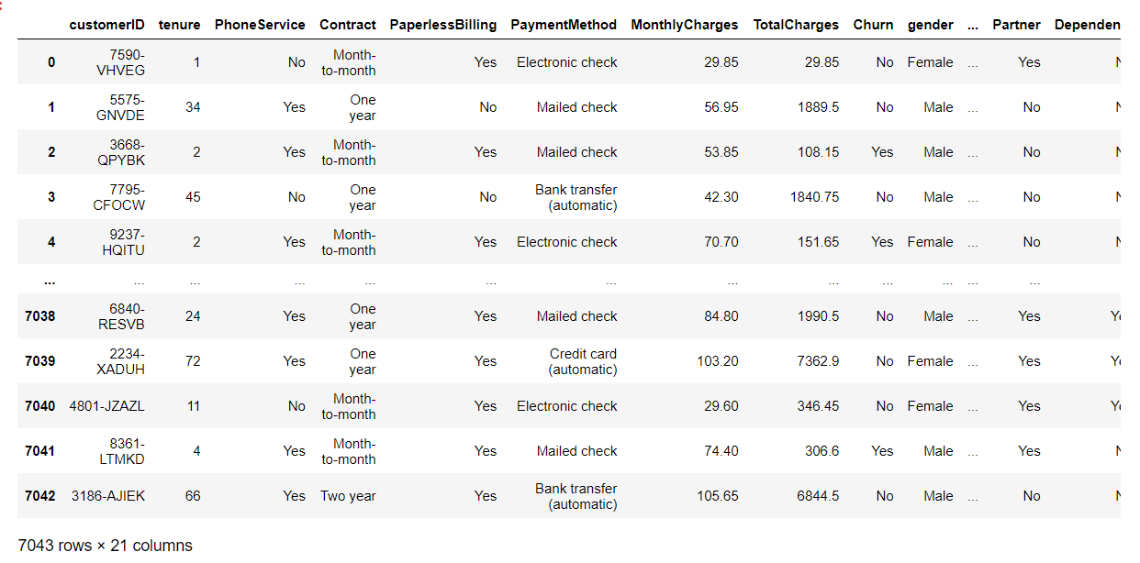
Dataset Summary
Churn Data Customer Data
Internet Data Merged New Data

Slide 7

Exploratory Data Analysis
Pre-processing
Data Types of ‘merged_new’ Dataset
Describe the Data
Null Values and Add Mean
Duplicated Values
Unique Values
Remove Unused Columns e.g. customerID
Perform Uni-variate and Bi-variate analysis

Slide 8
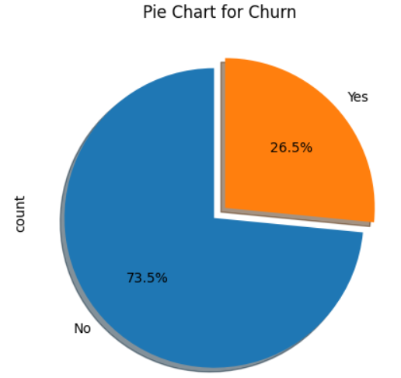
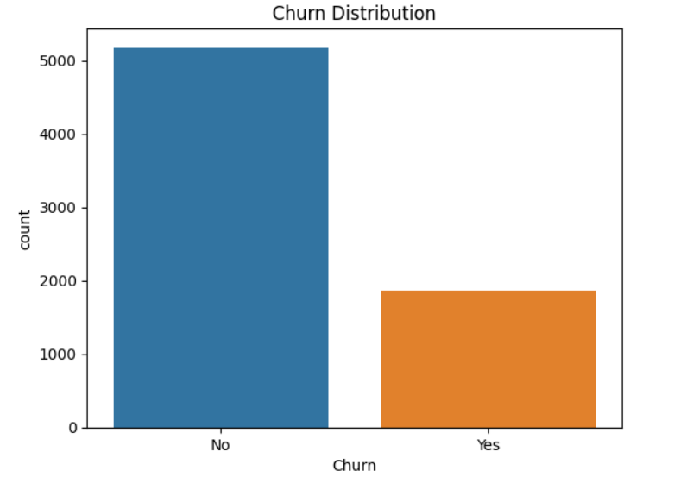
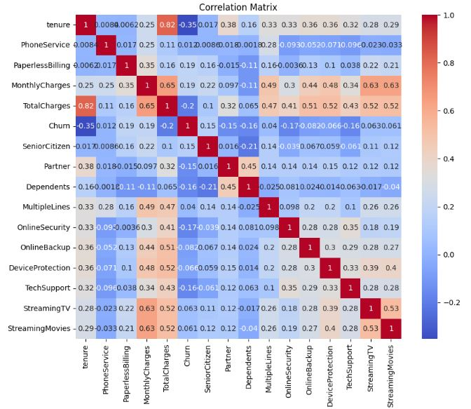
Data Visualization
Analysing Dependent Variable Churn
Non-Churn : 5174 (73.5%)
Churn : 1869 (26.5%)
Imbalanced Data

Slide 9
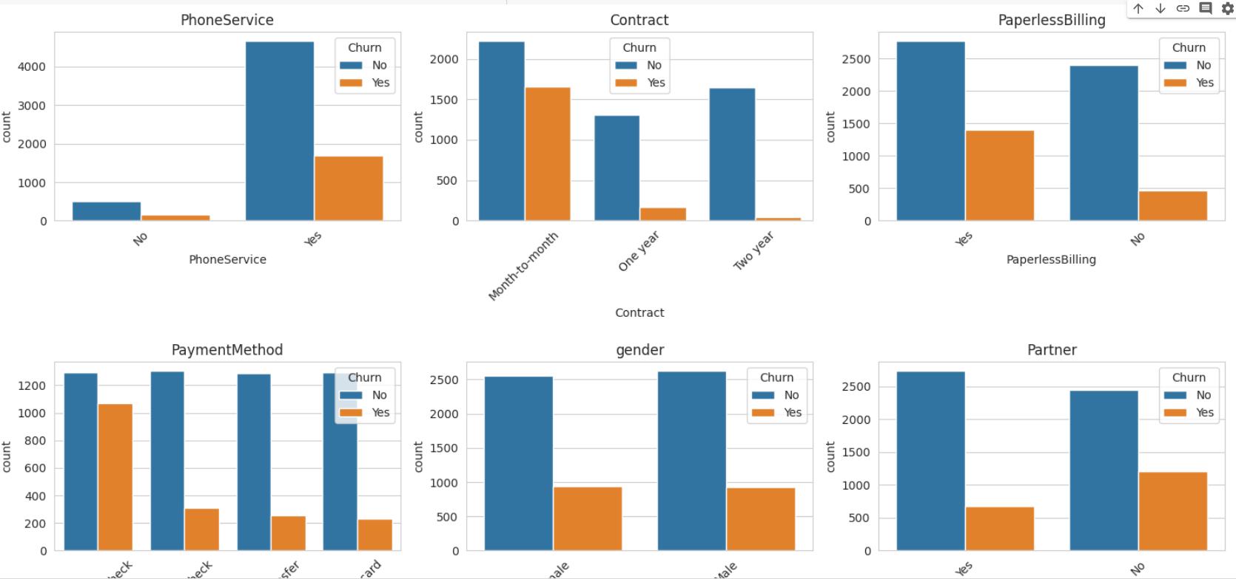
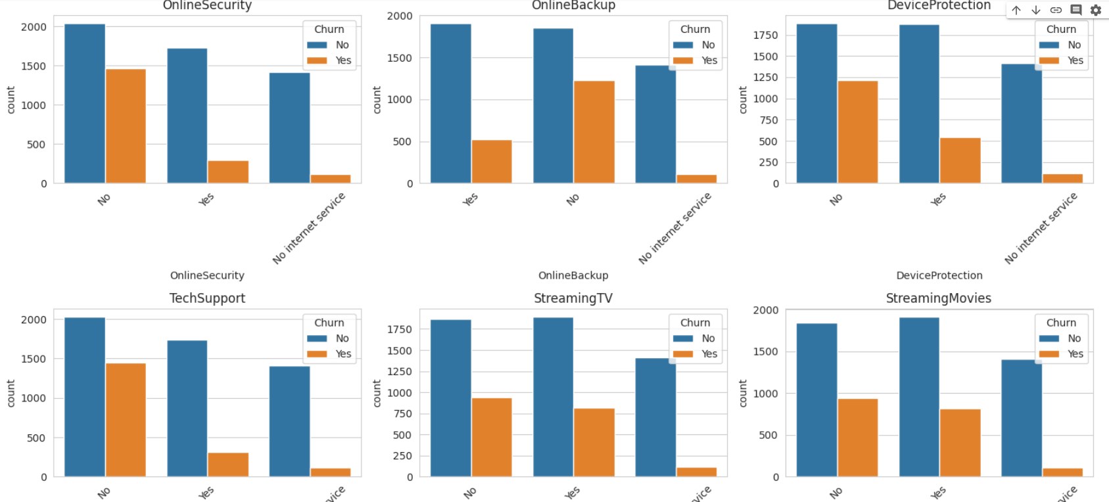
Data Visualization
Analyzing columns with churn columns

Slide 10
Feature Engineering/ Selection
Churn Prediction Model
Training Data
5) Update
1) Build
Model
Real
Independent
4) Predict
2) Test
Testing Data
3) Test=Ok

Slide 11
Model Building
We build some model
Logistic Regression
Random Forest
Decision Tree
XGBoost
KNN
SVM
Using Smote to Address Data Imbalance
Three Parameters for Imbalancing the Data
Adressing the Data Imbalance further using Undersampling
Addressing the Data Imbalance further using Oversampling

Slide 12
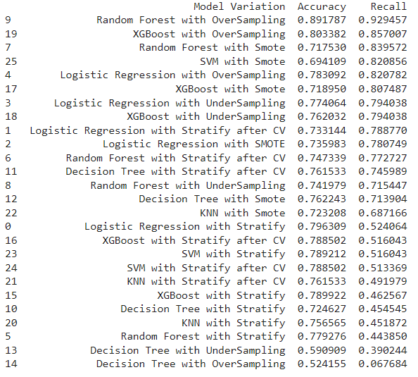
Model Building
Overall Revolution of Matrix
Random Forest with Oversampling looks good for the model deployment part
Customer retention being the primary criteria, minimizing the false negatives is crucial, meaning reducing the prediction where a customer is identified as not churned when they actually churned. Recall has therefore been identified as the main metric.

Slide 13
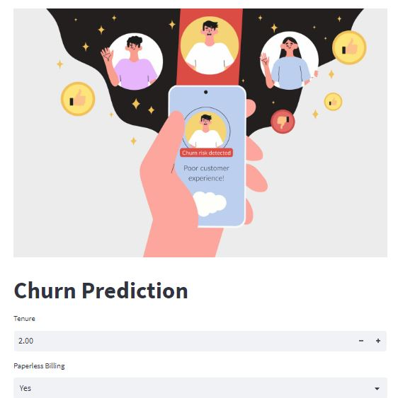
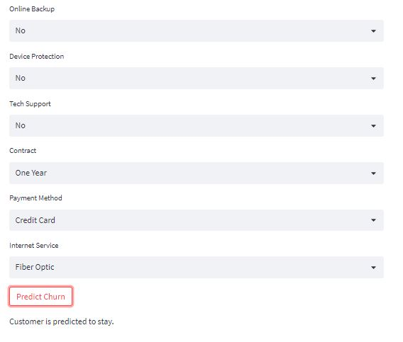
Model Deployment
Random Forest Classifier with Oversampling using streamlit.
Streamlit is a popular open-source framework used for model deployment by machine learning and data science teams.

Slide 14

Challenges
Data Preprocessing: Telecom datasets often contain a large volume of data, including structured and unstructured data. Cleaning, transforming, and integrating diverse data sources can be time-consuming and complex. Missing values, inconsistent data formats, and data inconsistencies need to be addressed to ensure the accuracy and reliability of the analysis.
Imbalanced Data: Churn datasets typically suffer from class imbalance, where the number of churned customers is significantly lower than non-churned customers. This can affect the performance of predictive models, leading to biased results.
Feature Engineering: Identifying relevant features from the available data is critical for building accurate churn prediction models.
Model Selection and Evaluation: Choosing the appropriate machine learning algorithms or models is crucial for accurate churn prediction. Different models, such as logistic regression, decision trees, random forests, have their own strengths and weaknesses. Evaluating and comparing the performance of various models can be challenging
Deployment: Successfully implementing churn prediction models in a telecom environment requires overcoming deployment challenges. It’s so difficult to do

Slide 15

Future Scope
Implementation on Real Time Data
Neural Network Implementation
Make Auto Recommender System

Slide 16

Conclusion
After conducting a thorough analysis of various models and applying different sampling techniques, it was determined that the Random Forest model with oversampling achieved the highest recall and accuracy for churn prediction.
The churn prediction analysis provides valuable insights for businesses. By leveraging the identified factors, organizations can make informed decisions to proactively retain customers. For example, offering personalized incentives or promotions based on contract type or payment preferences to help enhance customer satisfaction and loyalty.
-Churn prediction is an ongoing process that requires continuous improvement and adaptation. As customer preferences and market dynamics evolve, it's essential to regularly update and refine the models to ensure their accuracy and relevance.

Slide 17


